Slide 1


Project:- Second Level Authentication

Slide 2
Welcome!!
In this Project we are presenting a Second Level Authentication for end users.
.

Slide 3
AGENDA:
01
INTRODUCTION TO PROJECT
02
AIM OF SECOND LEVEL AITHENTICATION
03
FUNCTIONING OF SECOND LEVEL AUTHENTICATION
04
05
06
07

Slide 4
INTRODUCTION
Project Objective
The main objective of Multi Level Authentication is to allow only authorized users to enter into the systems and to deny access to unauthorized users and users have great security while accessing any information from systems.

Slide 5
AIM OF SECOND LEVEL ATUHENTICATION
1.To Allow only Authorized user.
2.To block the unauthorized users
3.More Securtiy
4.Less Breaching

Slide 6
FUNCTIONING OF SECOND LEVEL AUTHENTICATION
When user login their system successfully they are routed to our secong level authentication page for re-authentoication purpose.Where user can see two options of authentication.
First Option:- Simply OTP Login
Second Option:- Login With QR Code

Slide 7
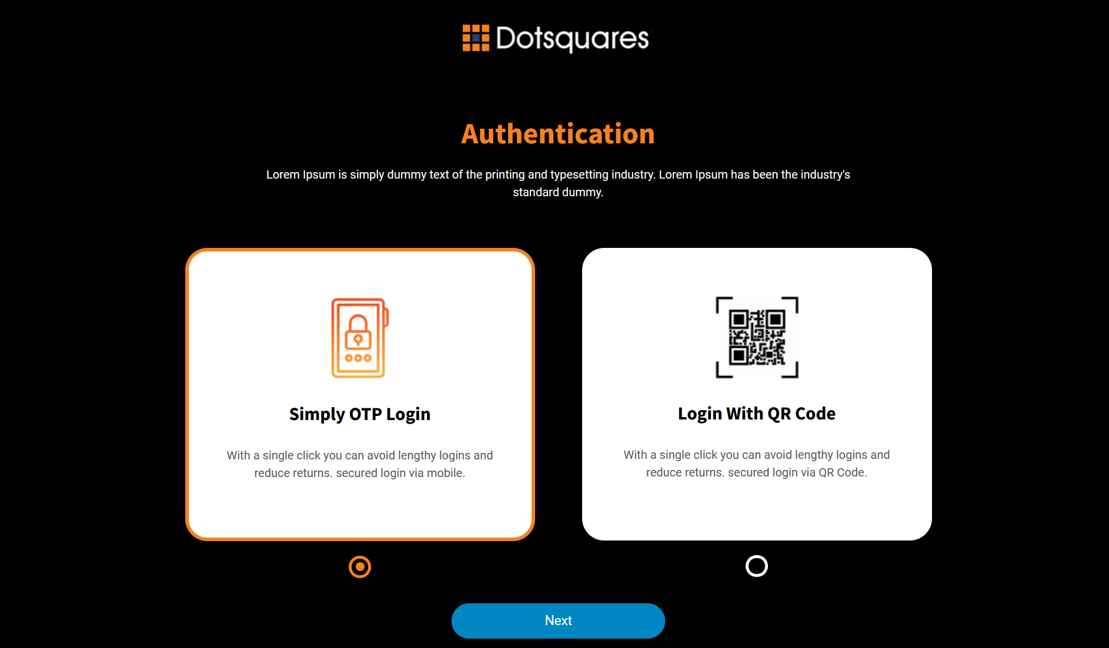
Authentication Page

Slide 8
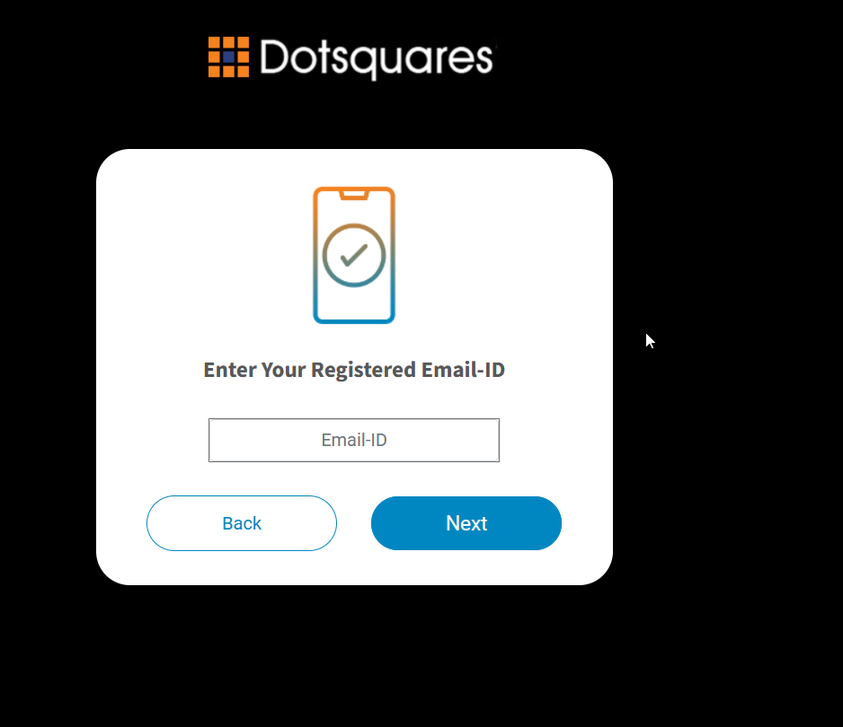
Authentication Page Next button Functionality While user opt to authenticate via OTP method and hit on Next button it will route user to verify Email page to enter their register email id.

Slide 9
Verify Email Page
In that email verify page two button functionality has provided to user.
Back Button:- On Pressing the back button it will lead user to come back to previous screen.
Next button:- When user enter his/her register email id, then by pressing on next button user will get an otp on his/her register mobile number and system route user to the verify otp page.

Slide 10
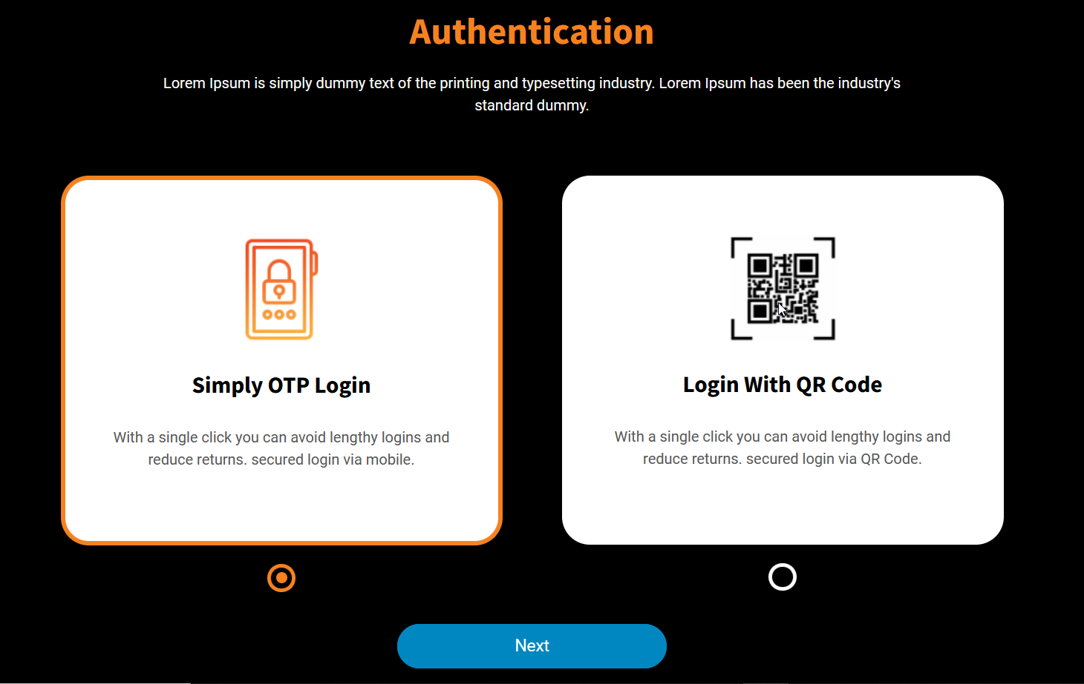
VerifyEmail Page Back Button Fucntionality Back Button:- On Pressing the back button it will lead user to come back to previous screen.

Slide 11
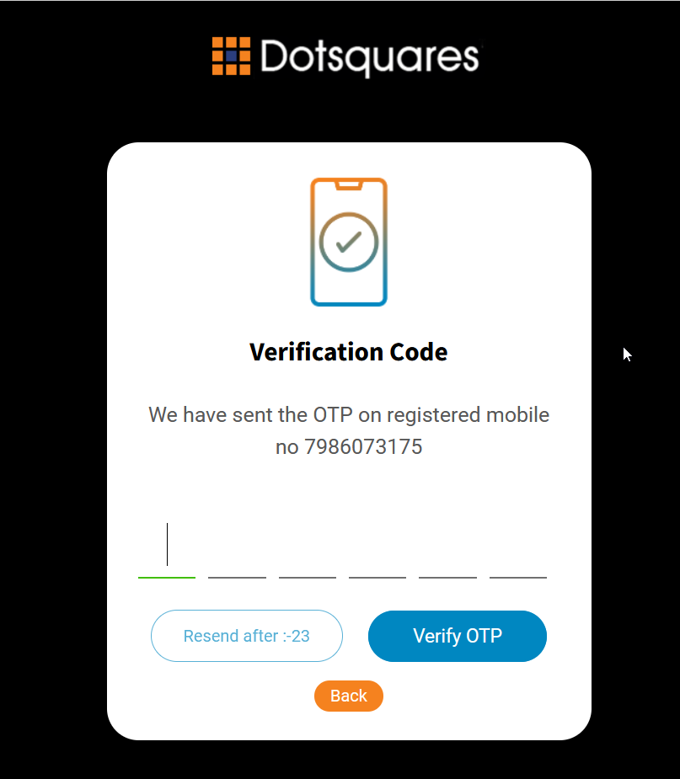
VerifyEmail Page Next Button Fucntionality Next button:- When user enter his/her valid register email id, then by pressing on next button user will get an otp on his/her register mobile number and system route user to the verify otp page.

Slide 12
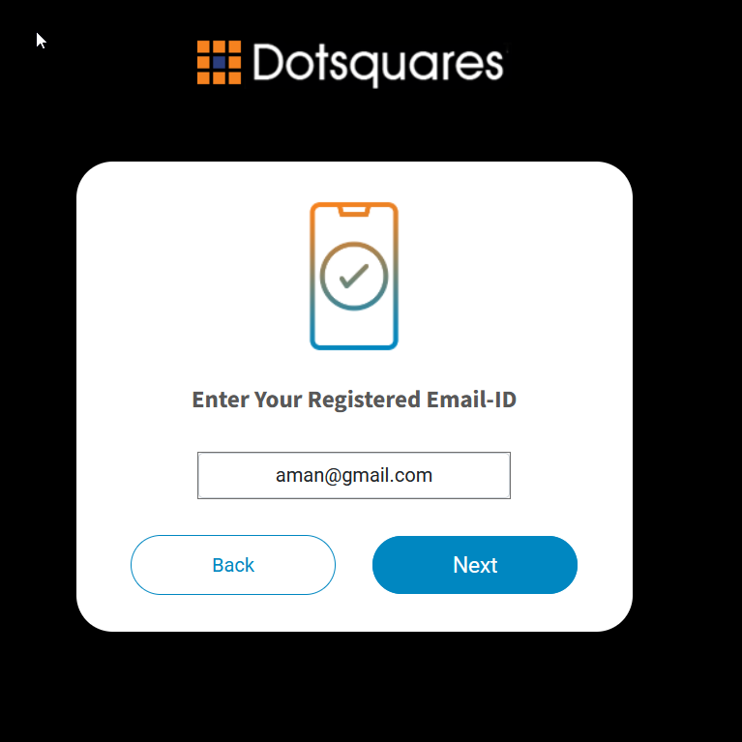
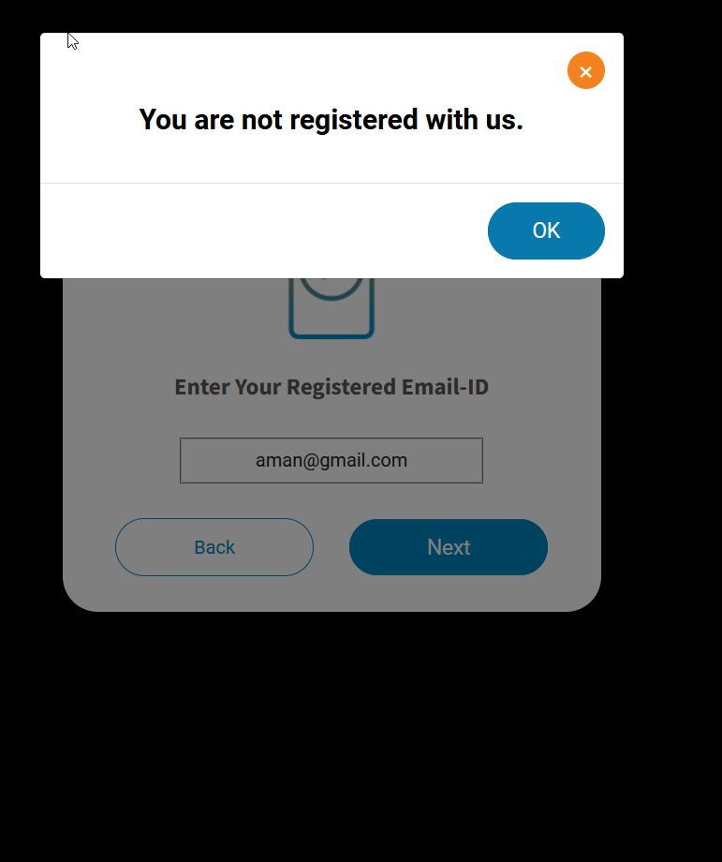
VerifyEmail Page Next Button Fucntionality
Next button:- When user enter email id which is not register, then by pressing on next button user will get an alert message which say “You are not register with us”.

Slide 13
Verify Otp Page
Upon entering valid email id in otp Verification page and press verify otp button it will route use to the directed page set by client.
In otp verification page user is provided with three button functionality.
Resend Button:- If the otp has been expired somehow and user want to get another otp on his register number then by pressing resend otp button user can generate another otp which will be sent to his/her register number.
If there is a case where user generated multiple otp, then only the recent otp is valid one all other are invalid otp.
Verify otp:- On pressing verify otp button system verify if enter otp is valid or not.On valid otp it will route user to directed page set by client.
Back button:- This button lead user to go back to previous page.

Slide 14
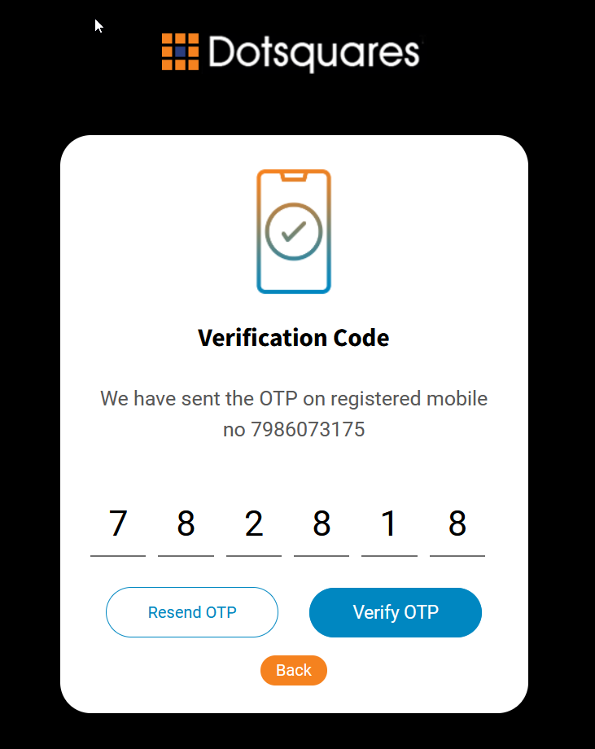
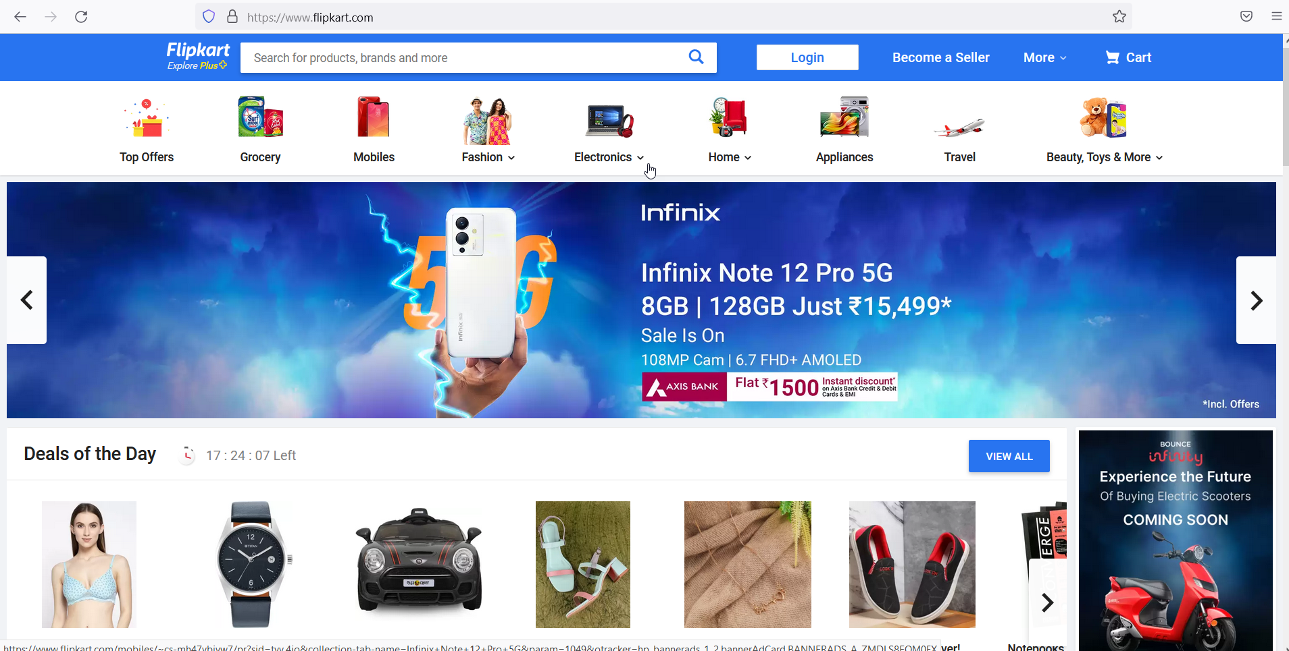
Verify Otp Button Functionality Verify otp:- On pressing verify otp button system verify if enter otp is valid or not.On valid otp it will route user to directed page set by Admin for client.

Slide 15
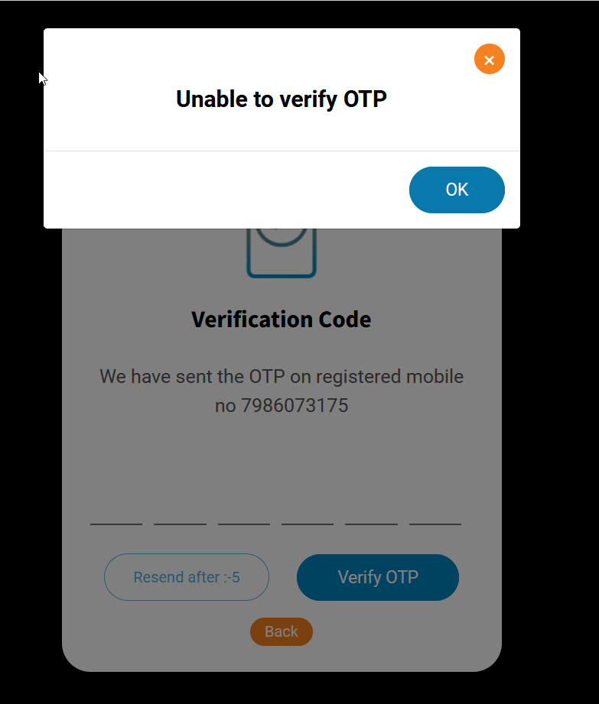
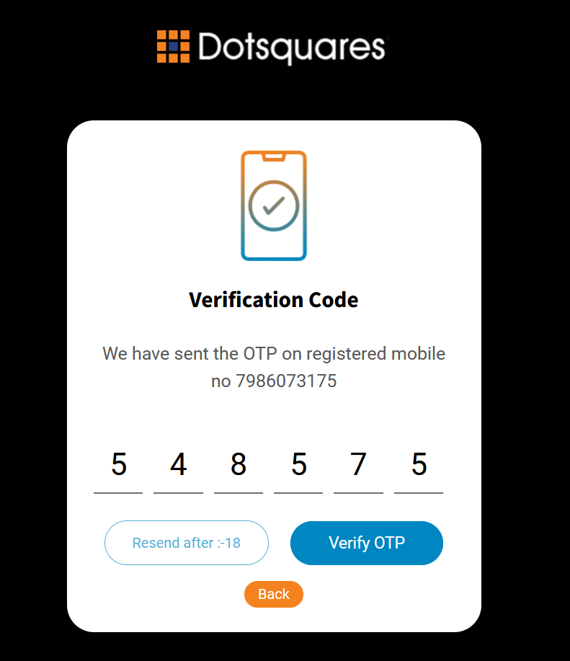
Verify Otp Button Functionality
Verify otp:- On pressing verify otp button system verify if enter otp is valid or not.If Otp is in-valid otp or user had entered old otp it will give pop-up message saying “Unable to verify Otp”.After pressing verify otp button system will autoclear the entered otp.

Slide 16
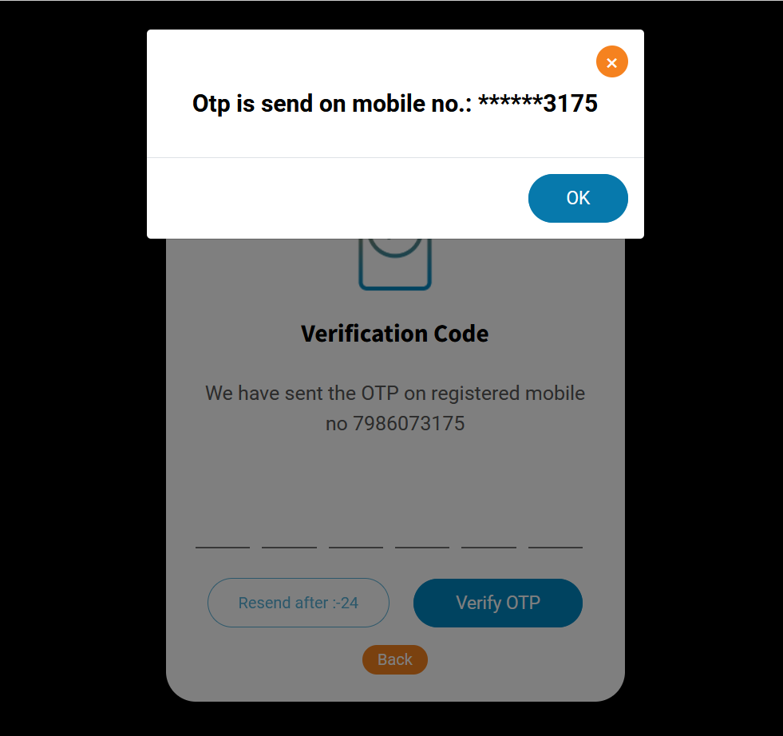
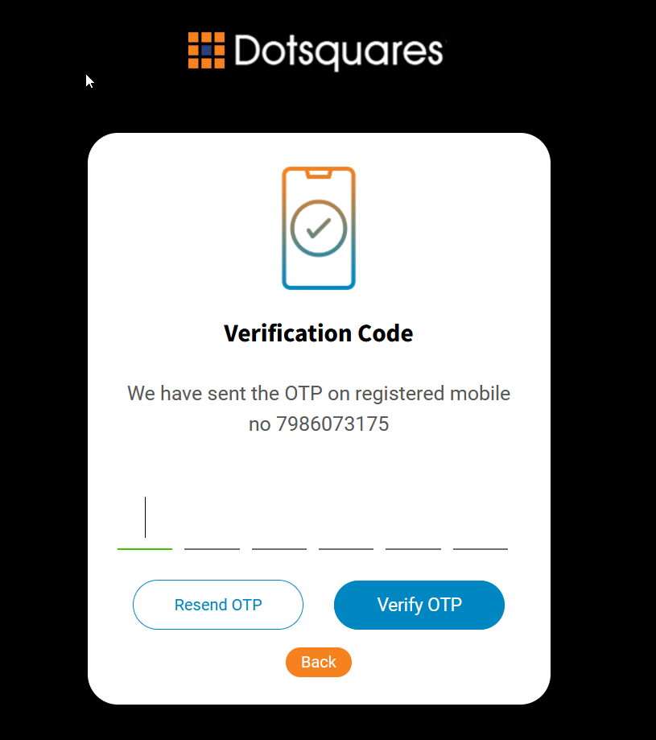
Verify Otp Page Resend button Functionality Resend Button:- If the otp has been expired somehow and user want to get another otp on his register number then by pressing resend otp button user can generate another otp which will be sent to his/her register number and a pop-up message will appear on screen which show otp is sent on which mobile number . On pressing resend otp button a 30 second count down timer will run which allow user to resend another otp only after 30 seconds timer get completes.

Slide 17
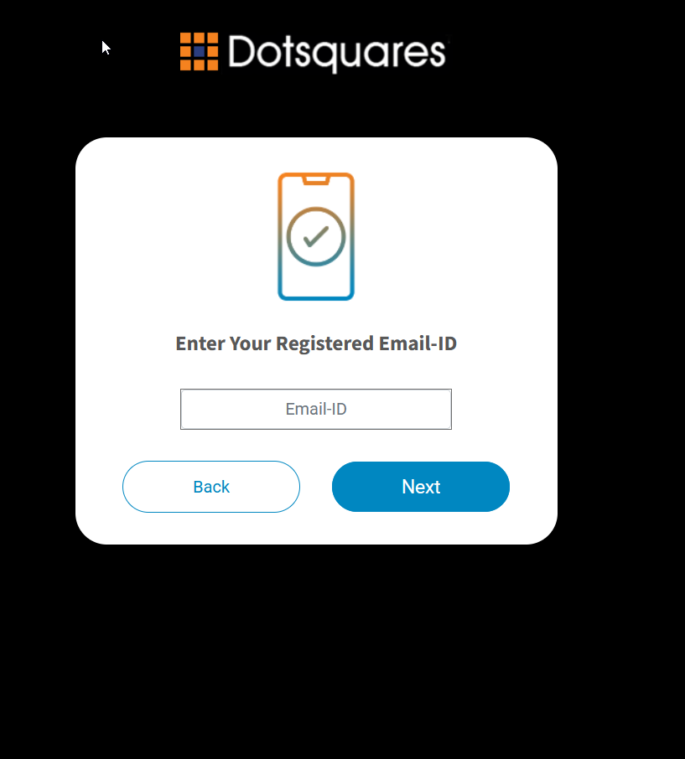
Verify Otp Page Back button functionality Back button:- This button lead user to go back to previous page which is Verify Email page.

Slide 18
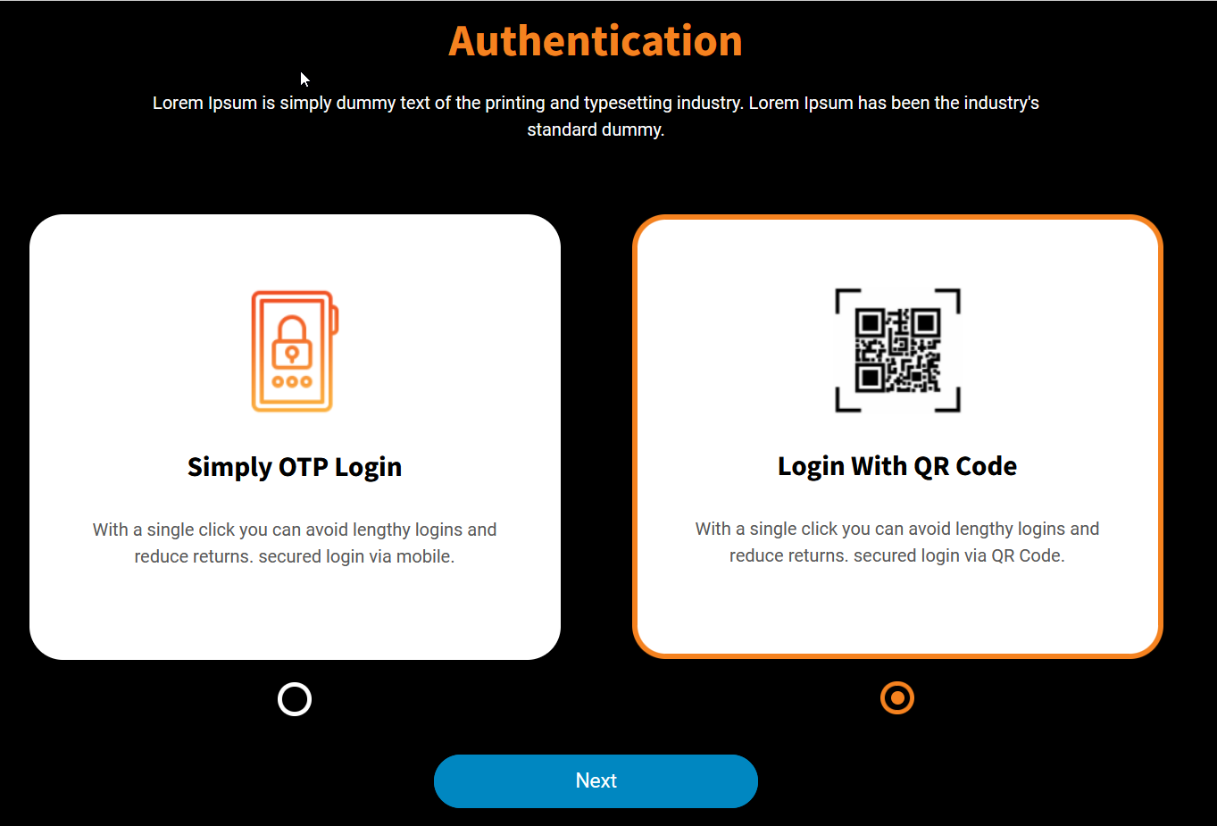
Authentication Page
Login With QR Code
In authentication page user is provided with two option.
First option:- Simply Login with Otp
Second Option:- Login With QR Code
user can select Login with QR code if he/she wants authenticate with QR code.

Slide 19
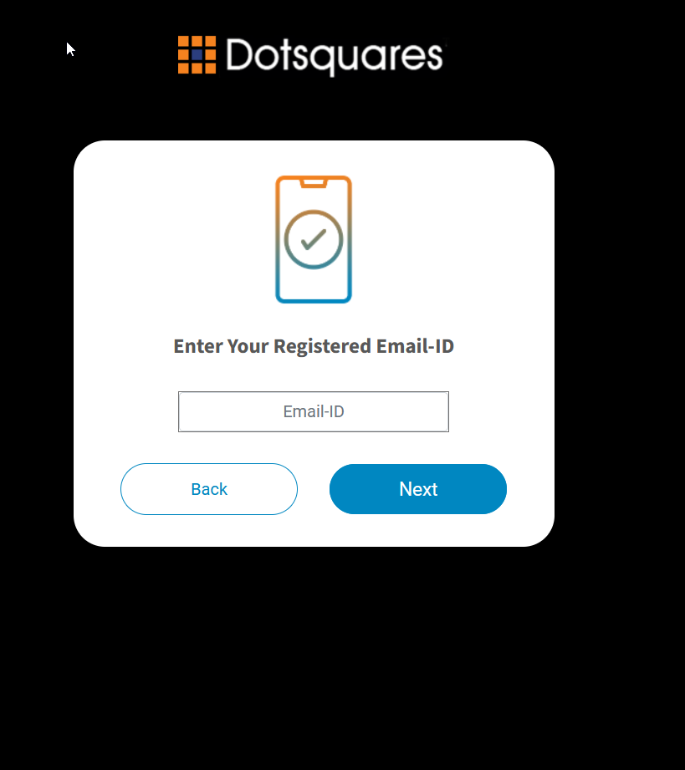
Authentication Page Next Button Functionality While user opt to authenticate via QR method and hit on Next button it will route user to verify Email page to enter their register email id.

Slide 20
Verify Email Page
In that email verify page two button functionality has provided to user.
Back Button:- On Pressing the back button it will lead user to come back to previous screen.
Next button:- When user enter his/her register email id, then by pressing on next button user will get an otp on his/her register mobile number and system route user to the verify otp page.

Slide 21
VerifyEmail Page Back Button Fucntionality Back Button:- On Pressing the back button it will lead user to come back to previous screen.

Slide 22
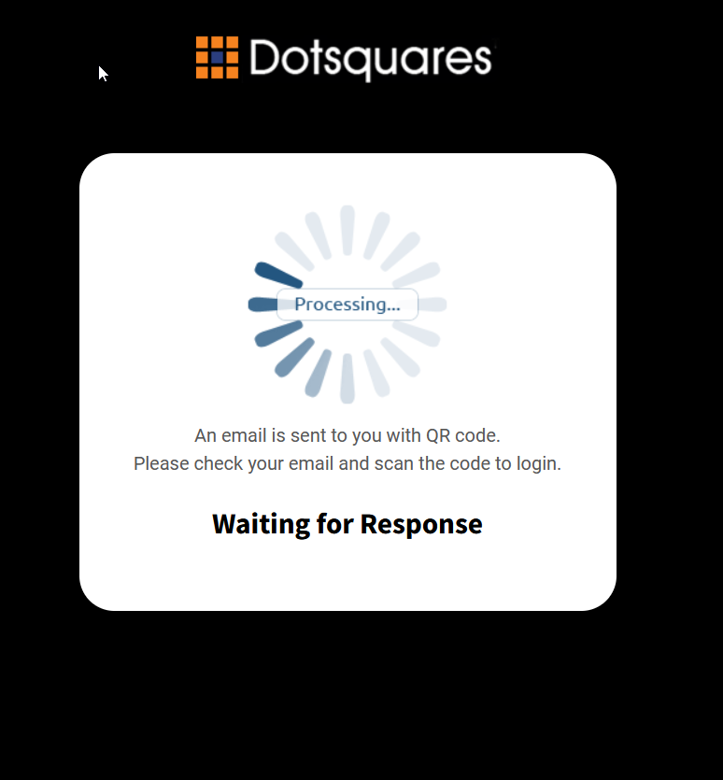
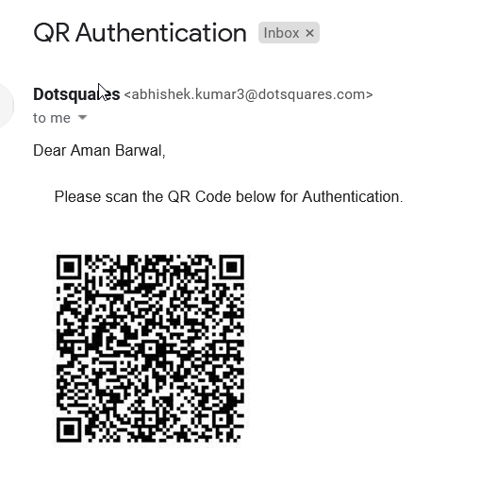
VerifyQR Page Next button:- When user enter his/her valid register email id, then by pressing on next button user will get a QR on his/her register email id and user will route to verifyQR page which show a message to user that an email is sent to you with QR code.

Slide 23
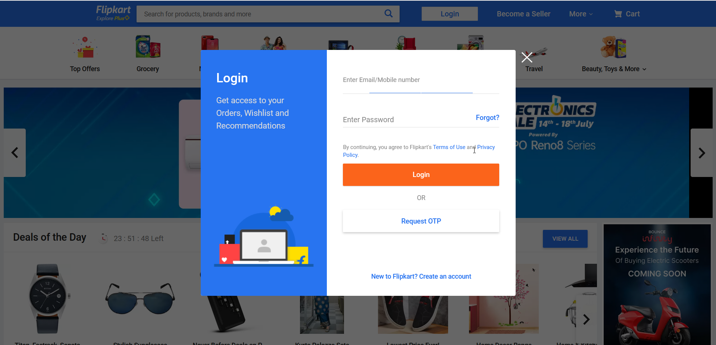
VerifyQR Page
Verify QR page wait for user to get that QR code scanned received on email id.When user scan that QR code successfully then user will route from verify QR page to the directed page set by admin for client.

Slide 24
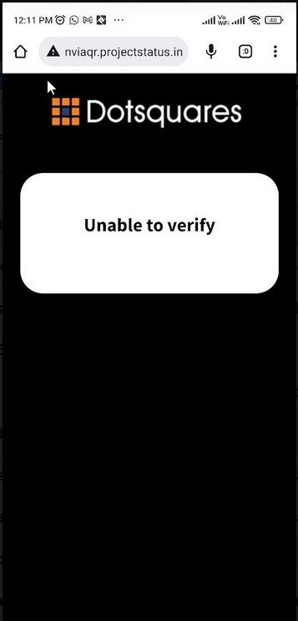
VerifyQR Page
If user intentionally or un-intentionaly generated multiple QR code then only the latest QR code will be the valid one all other are invalid.
If user scan any older QR code with their cell phones then system will point to unable to verify page.

Slide 25
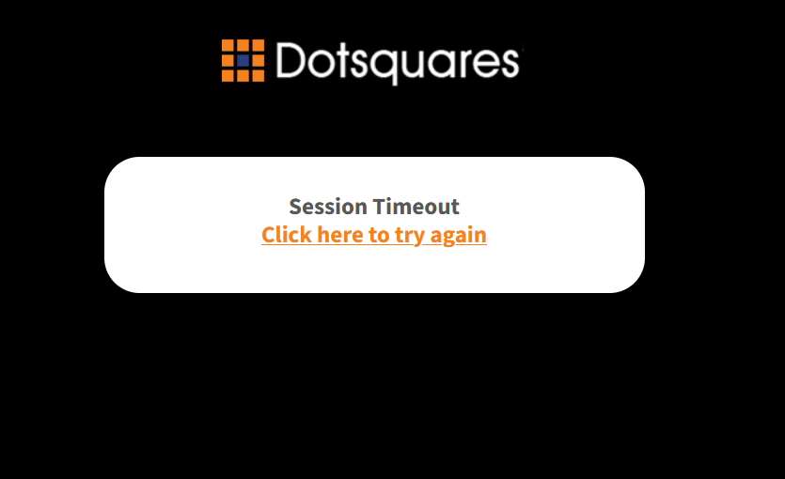
VerifyQR Page
If user scan the received QR code after the time limit then the Verify QR response page route user to the session time out page and user needs to re-generate a new QR code for authentication.

Slide 26
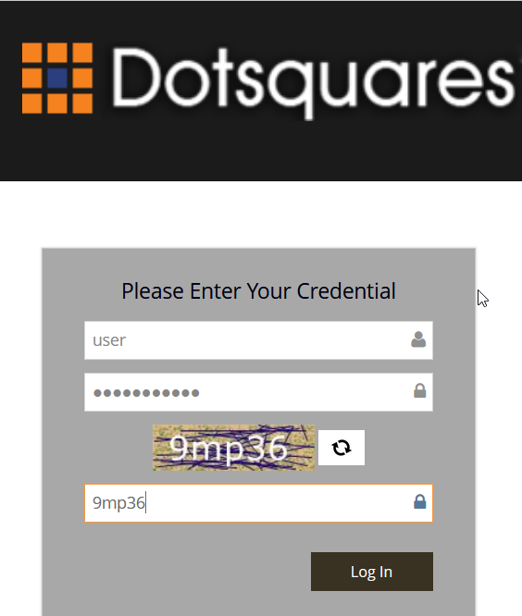
Admin Page Functionality
To do any modifcation in the client services so we provide admin control to this second level authentication where admin can add any new client, do any modification in the existing client details .For this we provide a login page so that only admin can have control and no one else.
Admin can enter to the dashboard by filling valid credentials on login pannel.

Slide 27
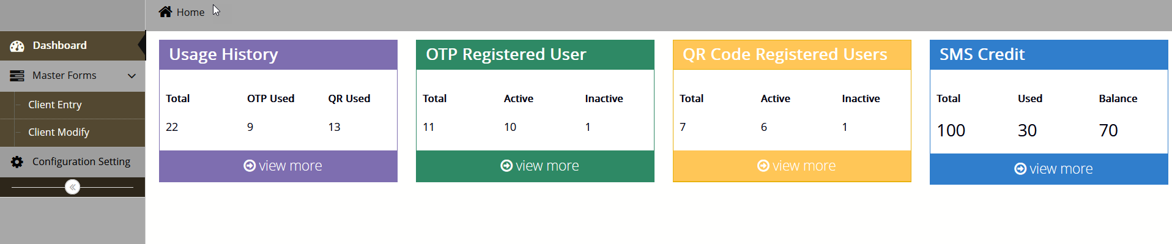
Admin Dashboard Page Functionality
When admin fill valid credentials and hit on login button system route the control to admin dashboard page.Where admin can see number of user who opt for QR code services and who opt for OTP services.Admin can also see how many user are active or inactive for that particular service.

Slide 28
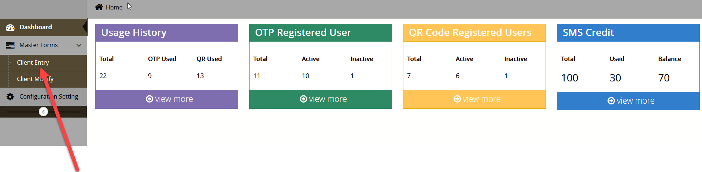
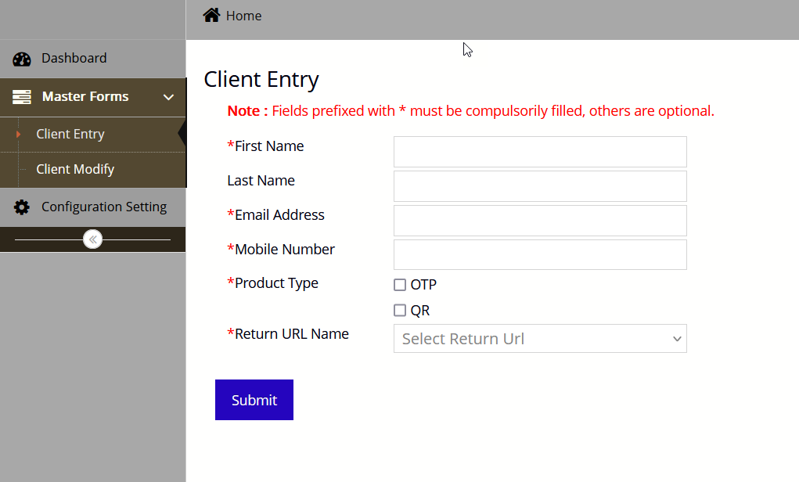
Admin Client Entry Page Functionality
If any new client come to admin for registration then on clicking the client entry link admin can register that client in database by giving the details in the client entry form.

Slide 29
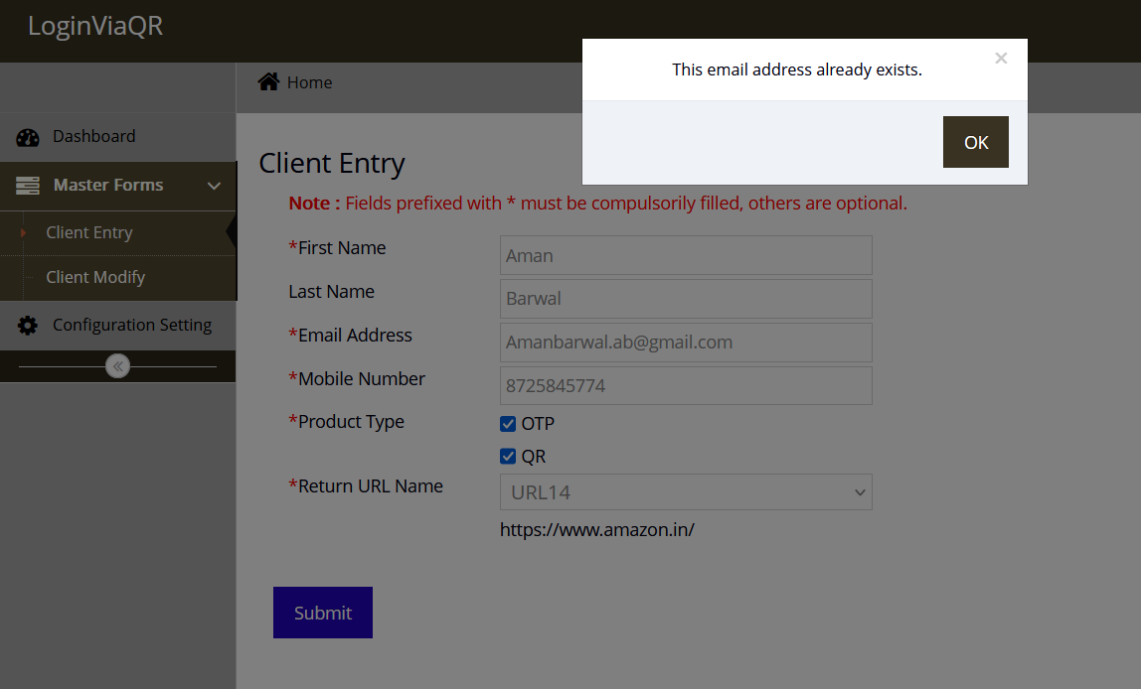
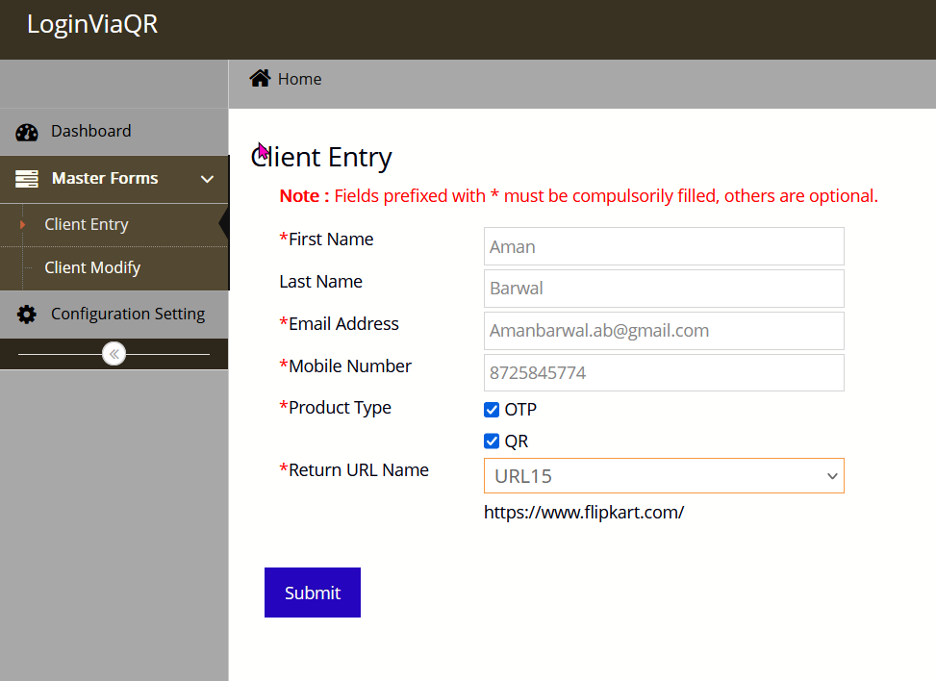
Admin Client Entry Page Functionality
If Admin try to enter any email id or Mobile number which is already exist in system then client entry form trigger a warning message that this email id already exist.
From client entry page admin can decide services (OTP or QR)for the client and the URL where client wants to direct their users on successfull validation.

Slide 30
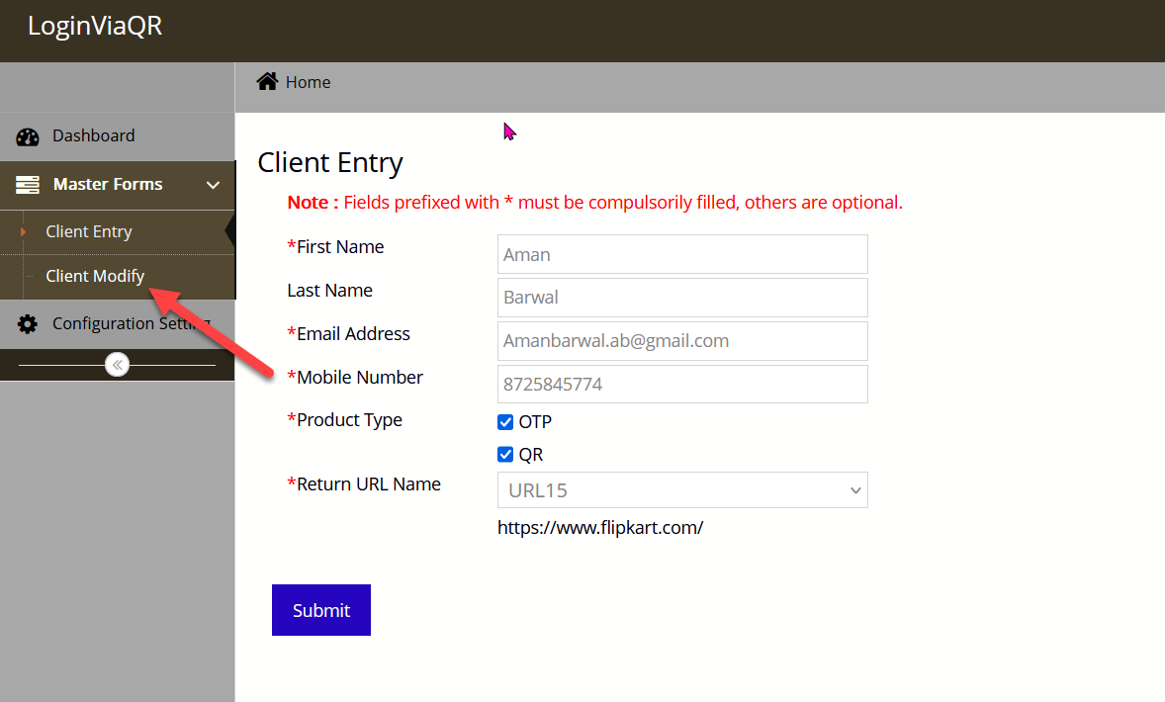
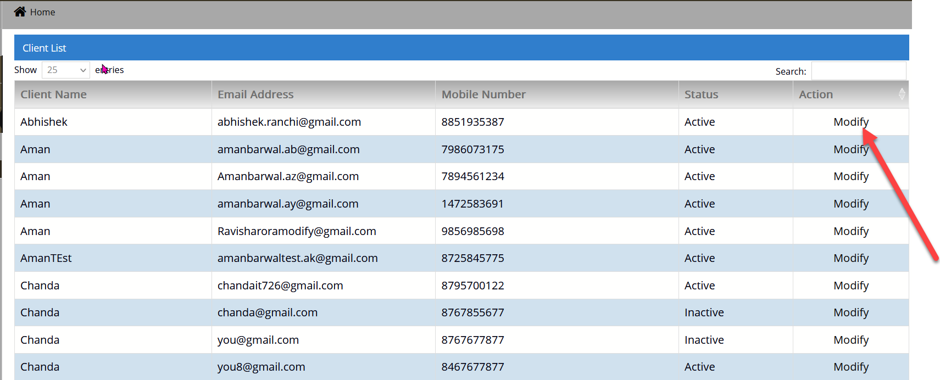
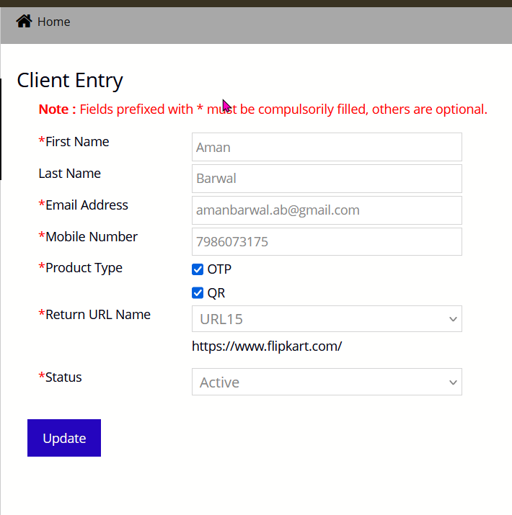
Admin Client Modify Page Functionality
Admin have the right to modify any client data ,for this admin needs to click the client modify link where admin can see the details of all the clients register.On clicking modify link admin can modify the details as per requirement.

Slide 31
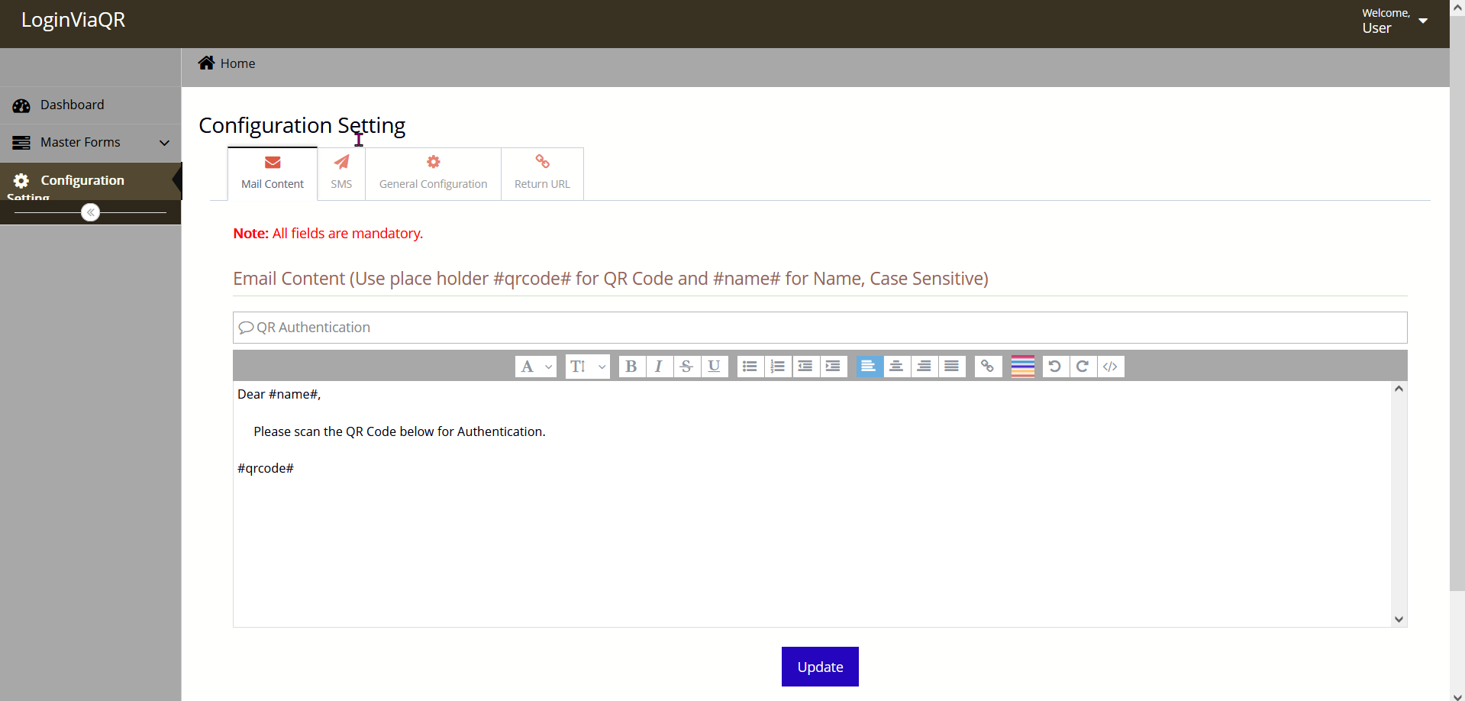
Admin Configuration setting page Functionality
In this section Admin can set the different content from different tabs like.
Mail content
SMS setting
General config
Return URL

Slide 32
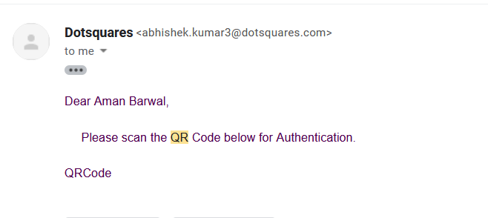
Admin Configuration setting page Functionality
Mail content:- In mail content Admin can set the content that is received to users on email when they generate QR code.

Slide 33
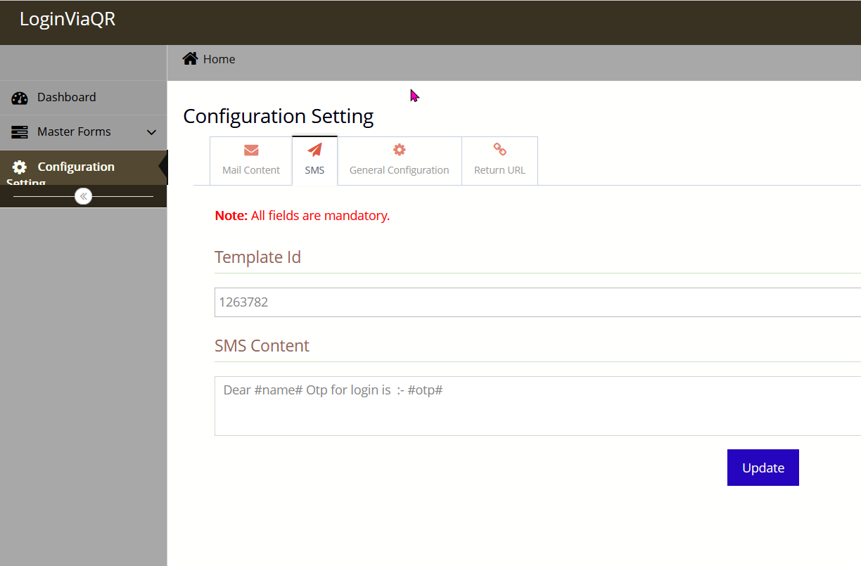
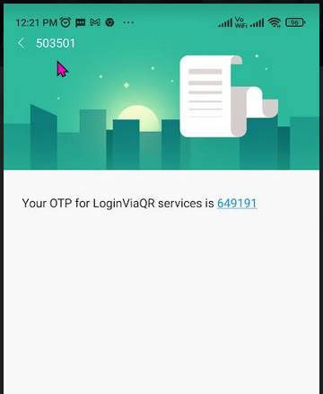
Admin Configuration setting page Functionality
SMS:- In SMS tab, Admin can set the text content received on register mobile number when user received an OTP.

Slide 34
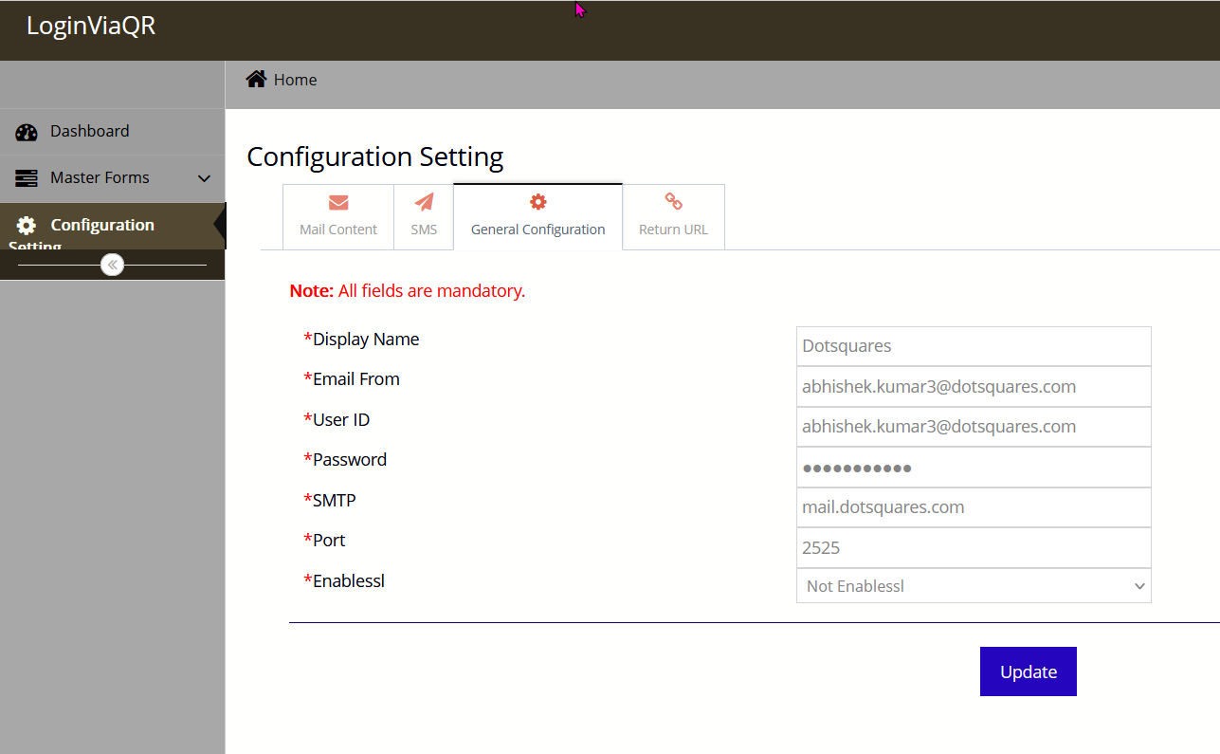
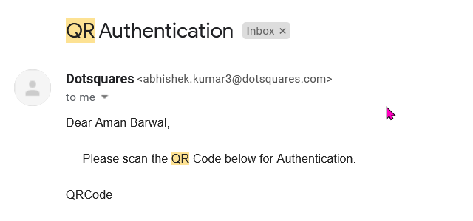
Admin Configuration setting page Functionality
General Configuration:- In this tab admin can set the content , Like Name,Email-Id,Email subject, Email From.

Slide 35
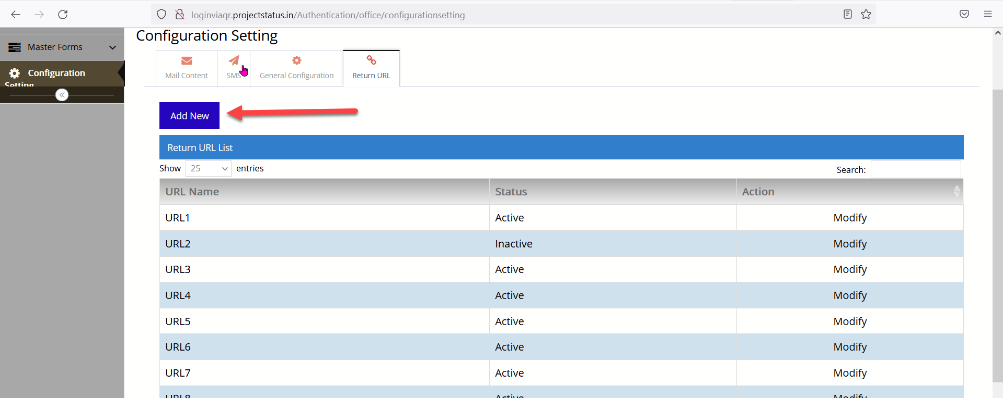
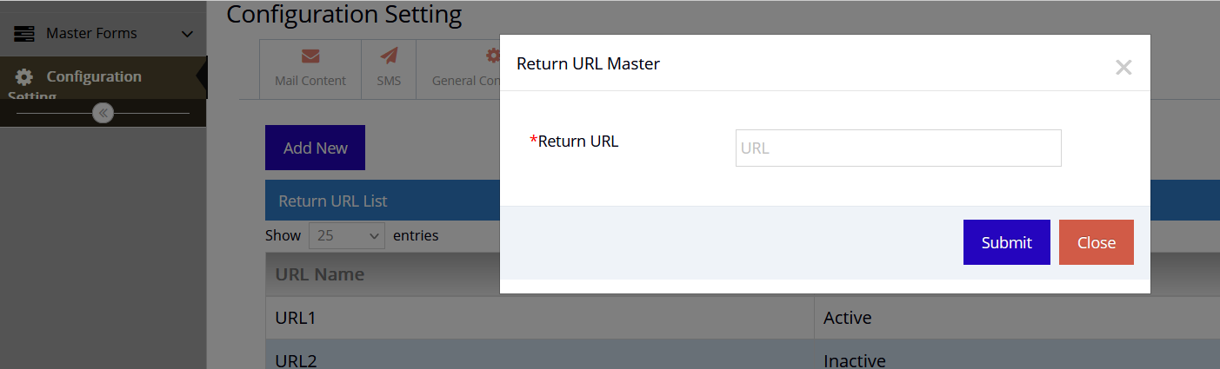
Admin Configuration setting page Functionality
Return URL:- In return URL tab admin can save the url where client wants to direct his users.Admin can save URL by clicking on Add New button and put the desired url in return URL input section and press submit button to save the URL.

Slide 36
Thank You !!

